Slide 1
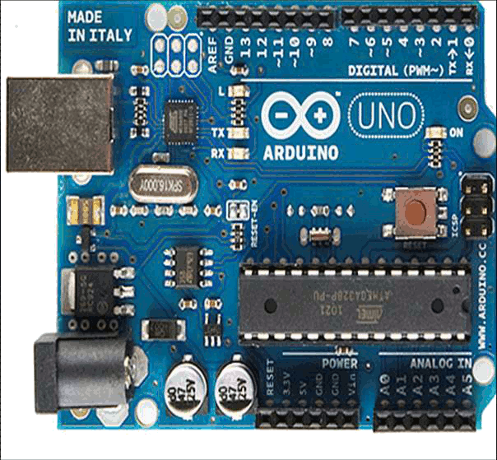
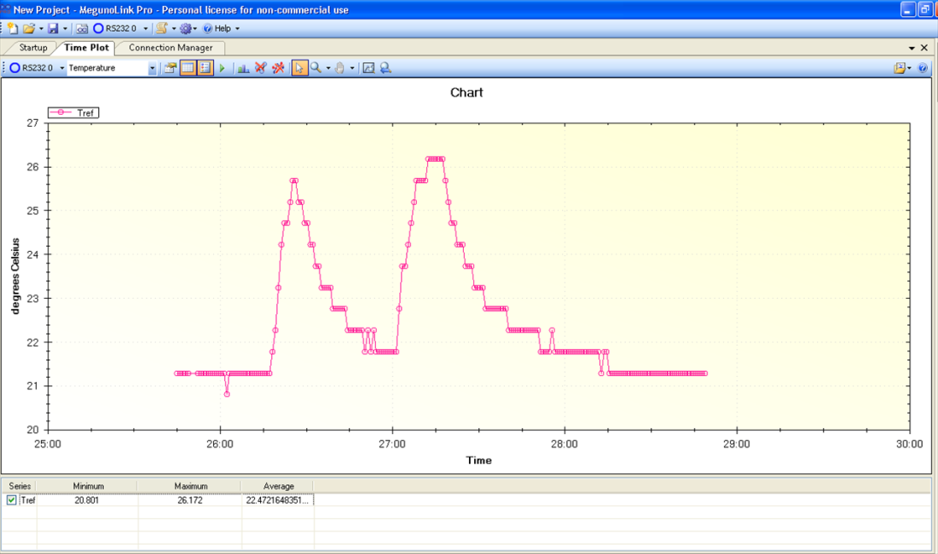
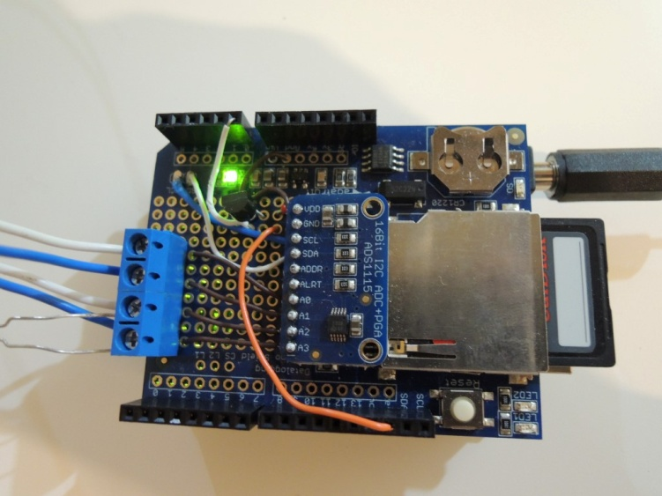
Next steps with Arduino

Slide 2
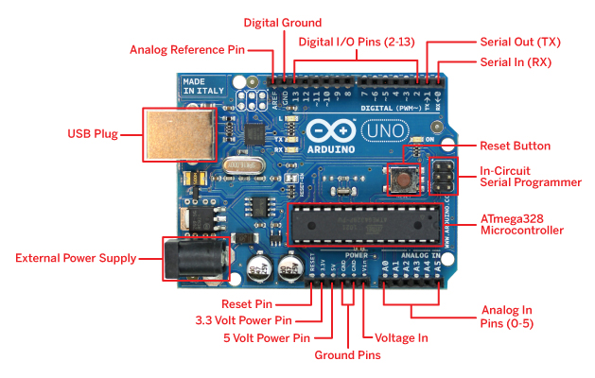
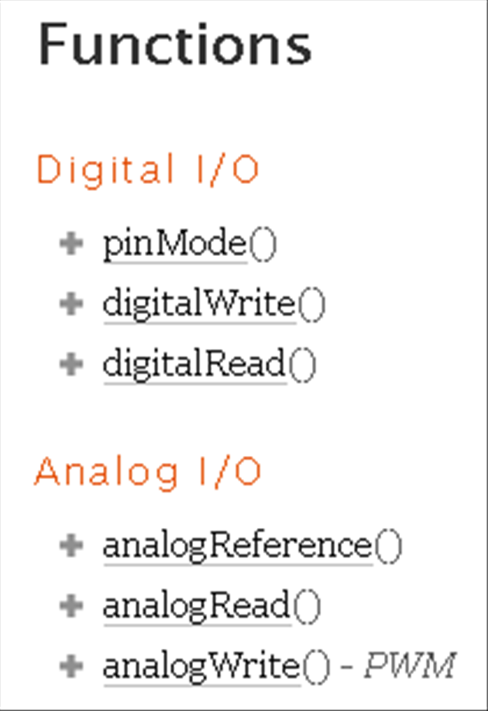
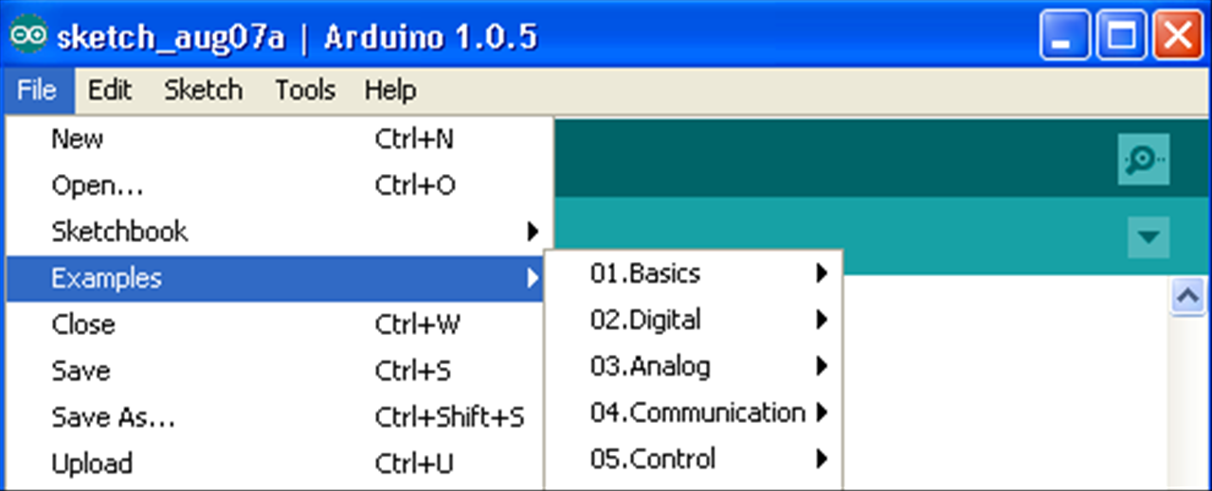
Analog Vs. digital
digitalWrite(led, HIGH); // turn the LED on (HIGH is the voltage level)
Reference:
Examples:

Slide 3

Analog and digitals pins
Digital pins: (http://arduino.cc/en/Tutorial/DigitalPins)
  input and output (I/O); initialization: pinMode(pin, INPUT);
Input pins: high impedance; Output pins: low impedance;
Digital pins have two states: HIGH and LOW
  output mode: HIGH =5[V] and LOW=0[V]
  input mode: reads HIGH if the pin reads V>2.7 and LOW if V<2.2
  You can set input pin to high state: activating the pull-up resistor
Pin 13 always reads LOW (integrated LED & resistor); harder to use a digital input
Analog pins can serve as digitals inputs(14-18)
digitalWrite(ledPin, HIGH); // sets the LED on

Slide 4
Analog and digitals pins
Analog pins: (http://arduino.cc/en/Tutorial/AnalogInputPins)
  Input pins: reads the ‘real’ voltage
  Convert the analog signal to digital (numbers)
  Uno’s ADC (analog digital converter) is of 10 bit:
    Return integer value between 0 to 1023 (divide the voltage range to 1023 sections)
    (Mega, Zero – 12 bits)
    Resolution depend on scale:
      5V: resolution is of 5000[mV]/1023=4.88[mV]
      3.3V: resolution is of 3300[mV]/1023=3.22[mV]
      1.1V: resolution is of 1100[mV]/1023=1.07[mV]
    Setting the voltage range: analogReference(type)
Val=analogRead (A0)

Slide 5
Analog and digitals pins
Analog pins: (http://arduino.cc/en/Tutorial/AnalogInputPins)
    Setting the voltage range: analogReference(type)

Slide 6
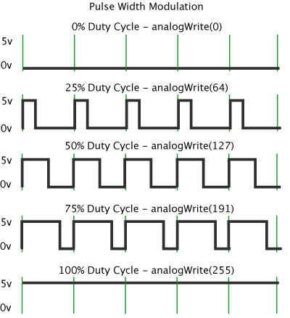
Analog and digitals signals
Analog pins can be used to output pins similarly to digital pins:
Analog output: (http://arduino.cc/en/Tutorial/PWM )
  For digital pins (confusing, isn’t it?)
  Pulse width modulation
    0-255 scale; @500HZ
    Only for ~pins: 3,5,6,9,10,11
  analogWrite(pin, value)
digitalWrite(A0, HIGH); // A0 is an Analog pin

Slide 7
Arduino Board Overview
http://arduino-info.wikispaces.com/ArduinoPinCurrent
Arduino I/O pins:
  10 bits (Uno) with an effective frequency of up to 8000 Hz
    10 bits: counts from 0 to 1023
  Output of 3.3/5V from digital pins
  Maximum Ratings:
  DC Current per I/O pin – 40.0 mA (tested @ 20 mA)
  DC Current VCC and GND Pins – 200.0 mA
  1 VCC pin: Means these Arduinos can Source a total of 200mA
  2 GND pins: Means these Arduinos can Sink a total of 400mA
  http://playground.arduino.cc/Main/ArduinoPinCurrentLimitations
  Max data transfer speeds:115kbits(serial); 400kbits (I2C); 4Mbits (SPI)
  https://sites.google.com/site/measuringstuff/the-arduino

Slide 8
Timing
http://arduino.cc/en/Reference/millis
    millis();
      Returns the number of milliseconds since the Arduino board began running the current program; will overflow after ~50 days.
      An example for creating one second intervals:
      const int log_interval=1000; // the required interval in ms
      …
      …
      delay((log_interval -1) - (millis() % log_interval));
      Serial.println(what ever you wish to print);
% is the modulus operator
1

Slide 9
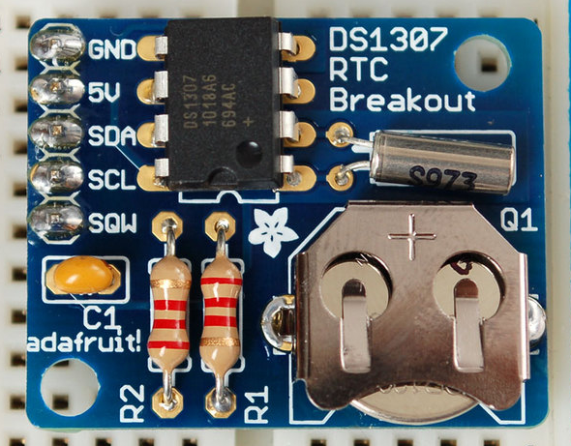
Timing
http://learn.adafruit.com/ds1307-real-time-clock-breakout-board-kit
    Real Time Clock – a fancy name for a watch
      Will return the time (and date) until its battery dies.
      Requires a special library: RTClib
      Communicates with Arduino board using I2C connection

Slide 10
Blink without delay
void loop()
{
// here is where you'd put code that needs to be running all the time. check to see if it's time to blink the LED; that is, if the difference between the current time and last time you blinked the LED is bigger than the interval at which you want to blink the LED.
unsigned long currentMillis = millis();
if(currentMillis - previousMillis >= interval) {
// save the last time you blinked the LED
previousMillis = currentMillis;
// if the LED is off turn it on and vice-versa:
if (ledState == LOW)
ledState = HIGH;
else
ledState = LOW;
// set the LED with the ledState of the variable:
digitalWrite(ledPin, ledState);
}
}

Slide 11
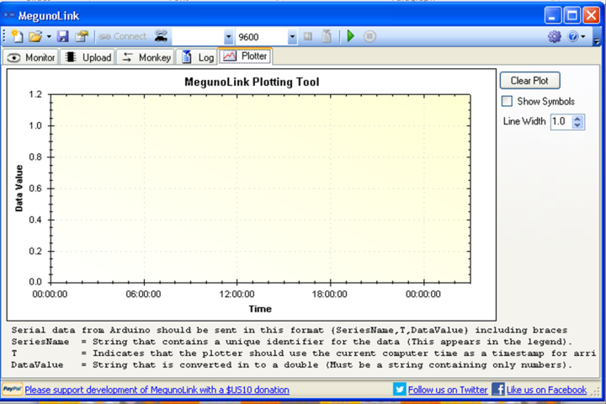
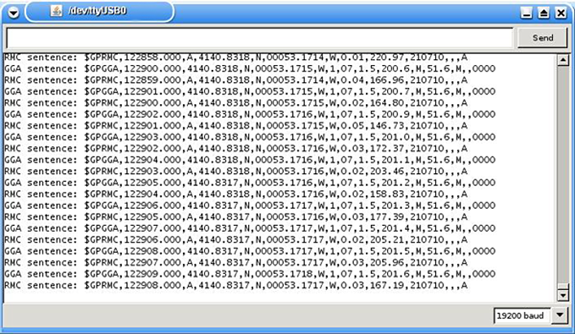
Logging and Graphical view of data
    Serial monitor: used to read or send data to the Arduino board
    Alternative programs: MegunuLink/python/Matlab

Slide 12
Megulonik
http://www.megunolink.com/megunolink-lite/megunolink-lite-plotting-tool/
Free software for logging, and visual view of data
Syntax: {SeriesName, T, DataValue}
SeriesName is a text string that contains a description of the data. It will be used as a series name in the legend of the plot.
T indicates the x-axis (time)
DataValue contains the data you want to plot.
Arduino Graphing Library

Slide 13
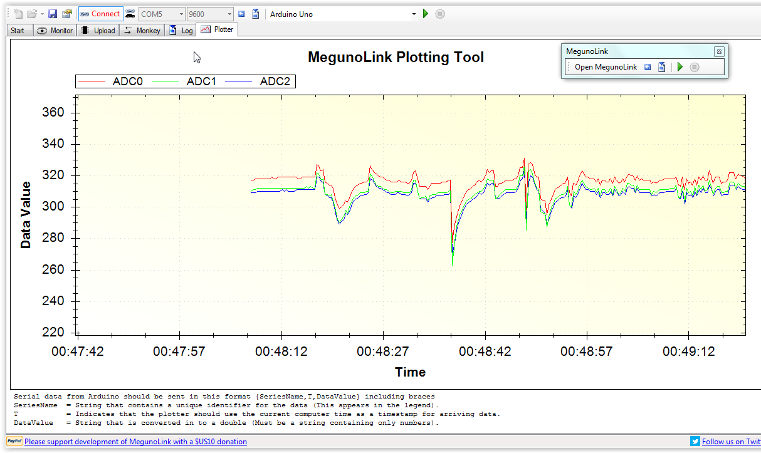

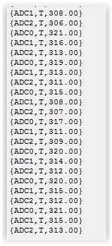
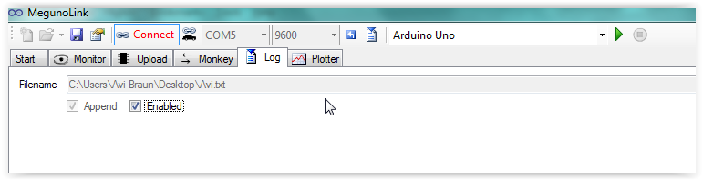
`

Slide 14
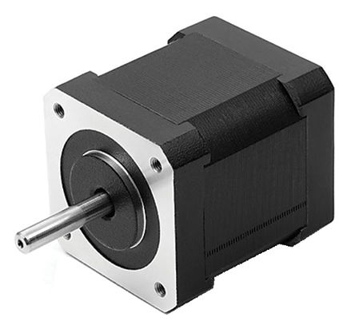
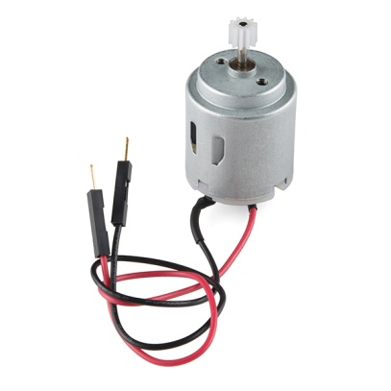
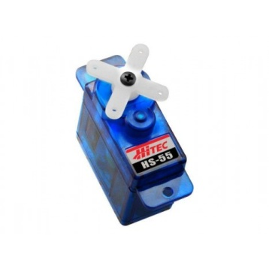
Motors
DC (Direct Current)
  two wire (power & ground), continuous rotation motors; high speed, low torque;
  Speed control via PWM
Servo: DC motor + gearing set + control circuit + position-sensor (usually a potentiometer).
  Accurate positioning (feedback); limited angle (usually)
  three wires (power, ground & control)
  Controlled by pulse duration; holding position
Servo library

Slide 15
Motors
Step motors
  multiple toothed electromagnets
  Moves in steps from one EM to another
  Slow; precise (without feedback); holding position
  Easier to control than Servo
http://www.4tronix.co.uk/arduino/Stepper-Motors.php
  Stepper library
  http://oomlout.com/a/products/ardx/circ-04/

Slide 16
Hands-on (45 min)
Install the Megunolink library
http://www.megunolink.com/download/GraphSeries.zip
Plot the measured temperature
Save the data to text file
In loop:
TimePlot(sensorTemp,"Tsensor");
At the end of the code:
void TimePlot(float data, String seriesName)
{ Serial.print("{");
Serial.print(seriesName);
Serial.print(",T,");
Serial.print(data, 3);
Serial.println("}");
}

Slide 17
Python:
http://playground.arduino.cc/Interfacing/Python
Matlab
http://uk.mathworks.com/discovery/arduino-programming-matlab-simulink.html
Labview:
https://www.labviewmakerhub.com/doku.php?id=projects:magesh:linx-temp-control-arduino:start
Processing:
https://processing.org/

Slide 18
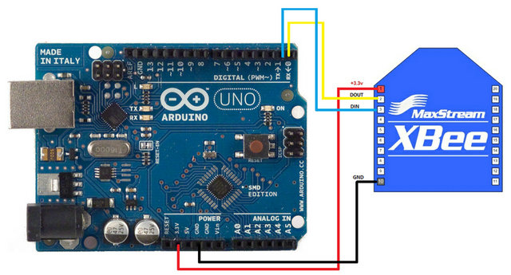

Communication methods:
    Zigbee/Xbee –
    IEEE 802.15.4 networking protocol for fast point-to-multipoint or peer-to-peer networking.
      Connects to sensors/arduino/computer (serial)
      100m-15mile!
    Bluetooth
    Ethernet
    wifi
    GSM

Slide 19
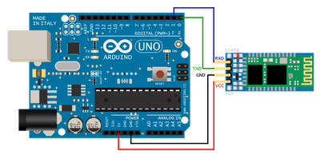
Communication methods:
    Zigbee/Xbee –
    IEEE 802.15.4 networking protocol for fast point-to-multipoint or peer-to-peer networking.
      Connects to sensors/arduino/computer (serial)
      100m-15mile!
    Ethernet
    wifi
    GSM
    Bluetooth

Slide 20
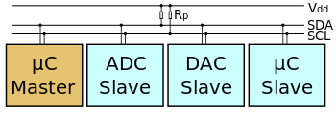
Digital sensors - I2C
http://arduino.cc/en/Reference/wire
    I2C connection (400kbits):
      Allows multiple connection with only two ports
      SCL (Serial clock line); SDA (Serial Data – 32 bits digital data)
        A5 and A4, respectively, on Arduino Uno
      Requires Library: wire.h
      Specific address for each connected device

Slide 21
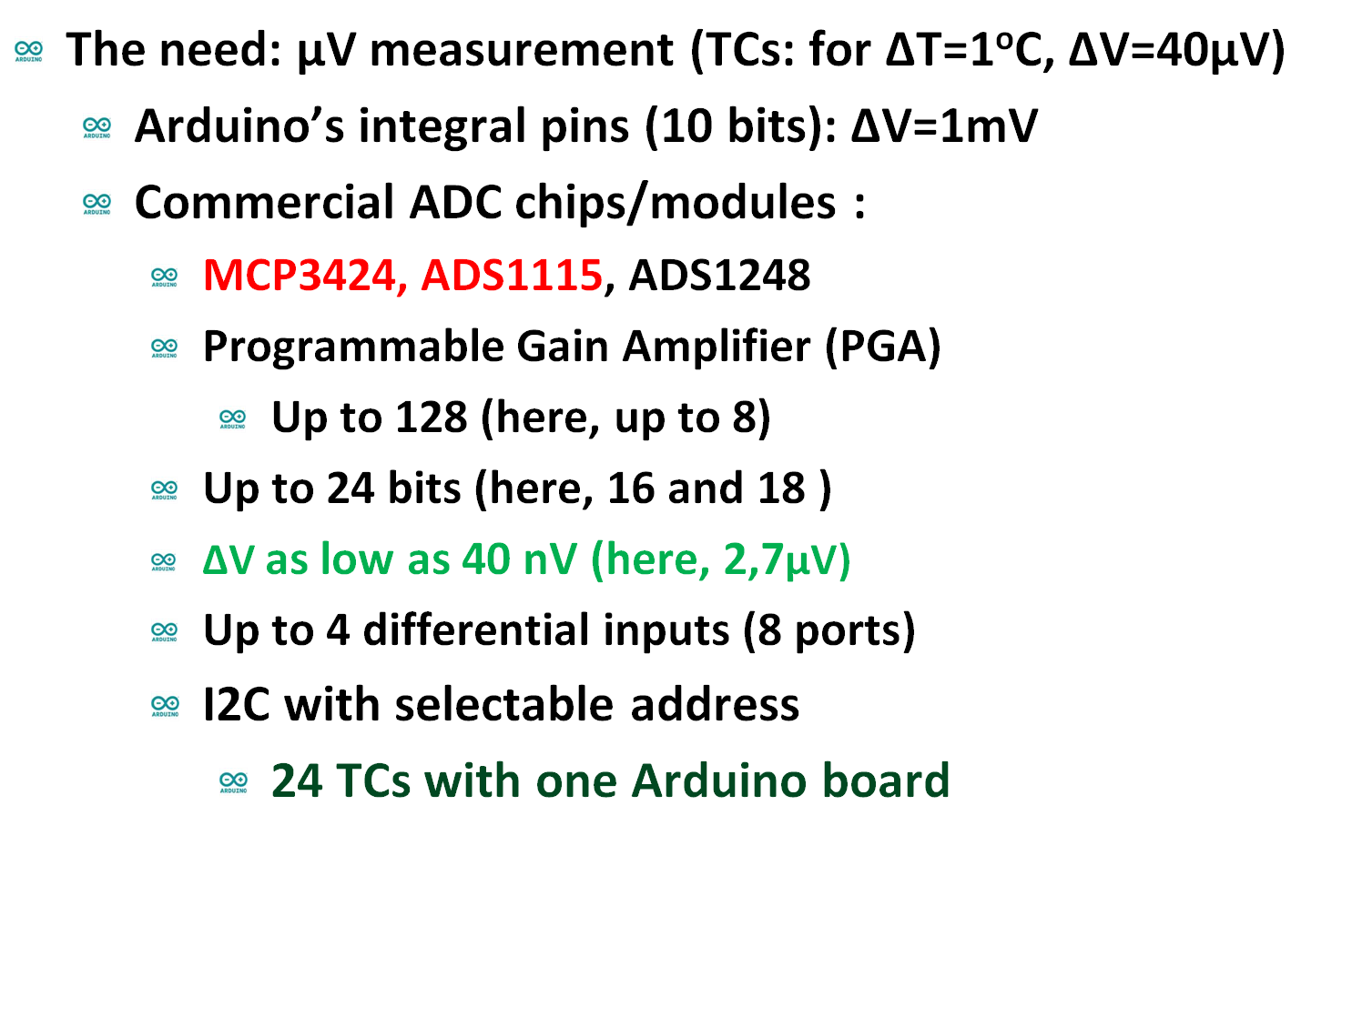
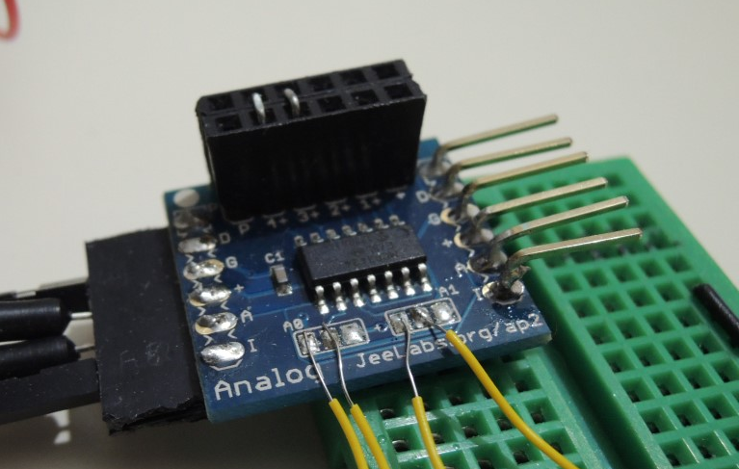
Digital sensors: high resolution ADCs
ΔV=2 μV
ΔV=7 μV

Slide 22
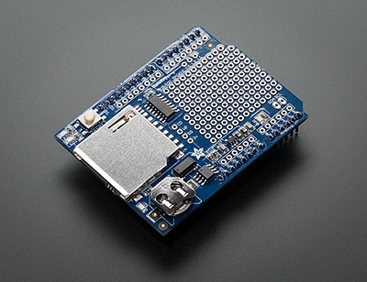
Data logging - SD card
http://arduino.cc/en/Reference/SD
http://learn.adafruit.com/adafruit-micro-sd-breakout-board-card-tutorial/examples
    Arduino’s internal memory:
      Flash 32k bytes for Sketch storing
      SRAM 2k bytes for creating and manipulates variables when the Sketch runs
      (EEPROM 1k byte for programmers long term information )
    SD card can expand the flash memory (4GB max?)
    Requires the Library: SD.h
      Open; read; write; remove; mkdir
    Communicates using an SPI connection

Slide 23
digital sensors –
Serial Peripheral Interface SPI
    SPI connection (4Mbits):
      Send/receive digital data to/from multiple SPI devices
      Require 4 ports (3 common and 1 specific per device):
        11;12;13 and 10 (for the Uno board)
      Requires Library: SPI.h
http://arduino.cc/en/Reference/SPI
MOSI (Master Out Slave In) - The Master line for sending data to the peripherals,
MISO (Master In Slave Out) - The Slave line for sending data to the master,
SCK (Serial Clock) - The clock pulses which synchronize data transmission generated by the master
and one line specific for every device:
SS (Slave Select) - the pin on each device that the master can use to enable and disable specific devices.

Slide 24
BIDR’s ArduLogger

Slide 25
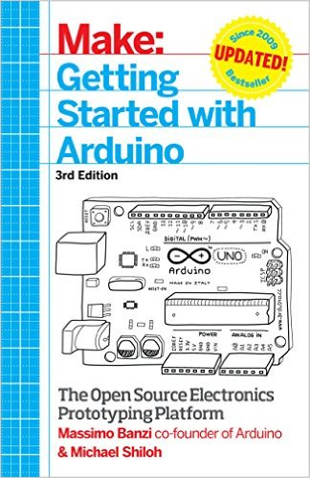


Getting Started with Arduino: The Open Source Electronics Prototyping Platform (Make) 3rd Edition
Arduino Cookbook, 2nd Edition (O’RRELY)
>600 pages!!!
Building Wireless Sensor Networks: with ZigBee, XBee, Arduino, and Processing 1st Edition (O’RRELY)

Slide 26
http://avi-braun.wix.com/arduino-ic-2015
Links:
• The official website - probably the best place to start at!
• Ladyada's Arduino tutorial - a well structured Arduino tutorial
• tronixstuff tutorials - in-depth tutorials for advanced Arduino topics
• Arduino Cookbook - the name says it all
• Jeremy Blum channel at YouTube
• AdaFruit - easy to follow tutorials for popular shields and modules
• SparkFun - tutorials (for arduino and electricity in general) and an active forum
• DFRobot - robots, drones, and others

Slide 27
Next steps with Arduino –
Using Arduino for lab work
?

Slide 28
Rx and Tx LEDs
Integrated LEDs:
Pin13
TX
RX
Serial communication
7-12V
10 bits
I2C (Inter-Integrated Circuit) and SPI (Serial Peripheral Interface)

Slide 29

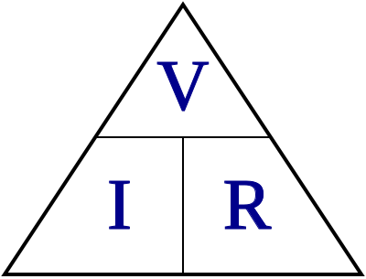
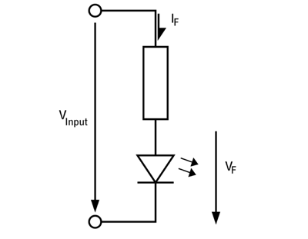

Ohm’s law
I=V/R; (or: V=I R; R=V/I)
The current equals to the voltage divided by the resistance
At short circuit (minimal resistane) the current is very high
We need to add resistors for a safe operation of LEDs:

Slide 30
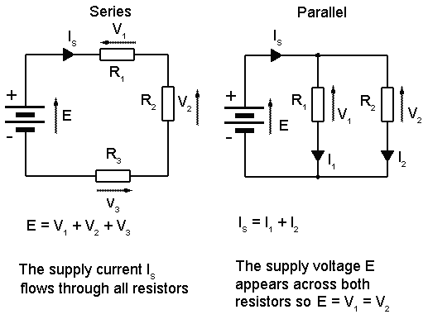
Parallel and series circuits
  Adding currents or adding voltage?
  Shunt

